Slide 2
Small RNA sequence and proteins are related
Dicer is what forms the sRNA molecules, by chopping a dsRNA precursor.
sRNA size is key for which AGO a sRNA uses, and therefore what function it performs.
Other factors affect how sRNAs find their AGO, and perform their function.
Not all sRNAs are equal
Is there a bias in the nucleotide position for Dicer chopping?
Is there a preference for how these are loaded into AGO?

Slide 3
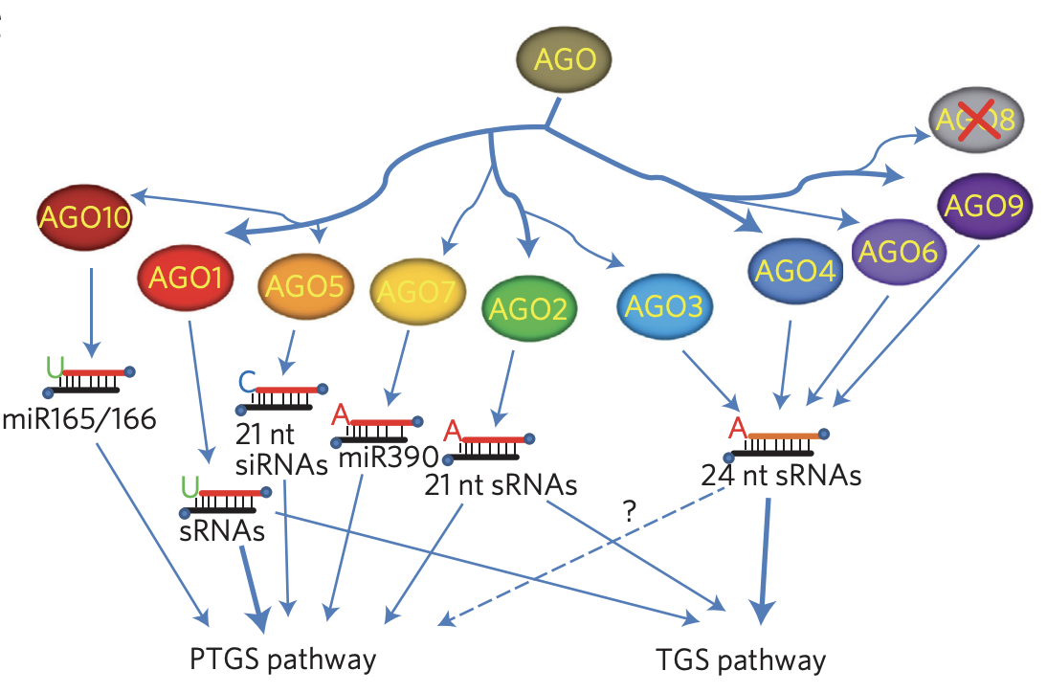
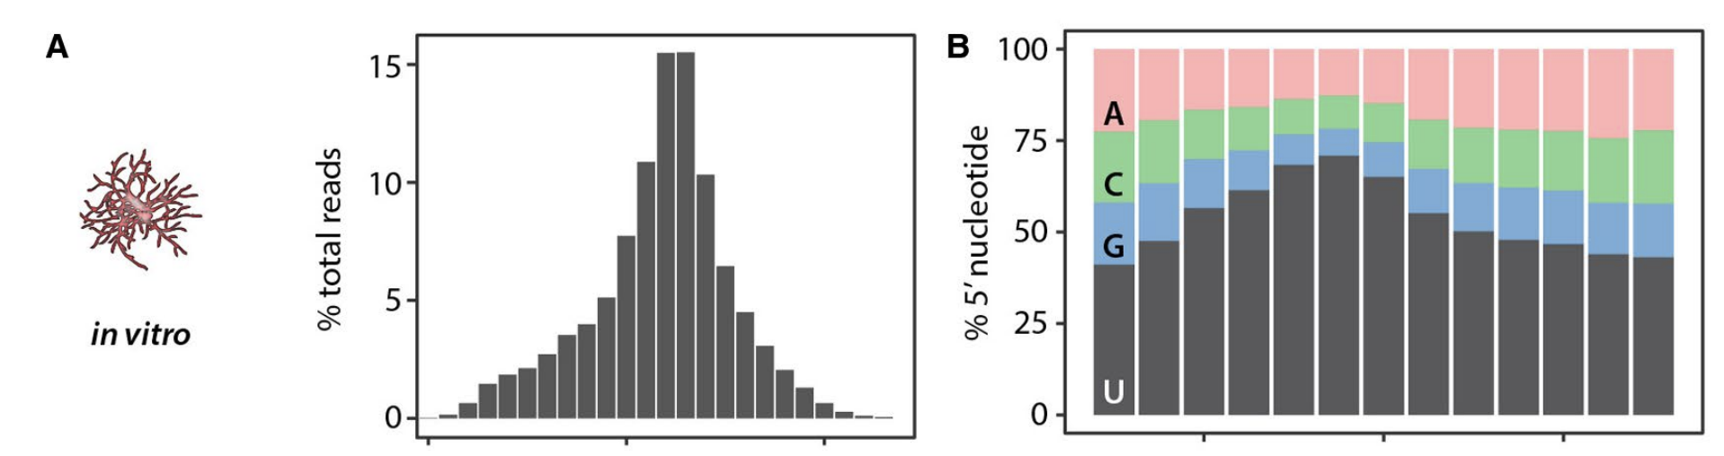
5’ nucleotide bias is common in sRNAs
This bias is due to the way that sRNAs are loaded into AGO - 5’ first with differing preferences for different AGOs.
Why do we see a bias if this isn’t related to how they are made? Shouldn’t we see the sRNAs that are not loaded also?
Plants
Sclerotinia sclerotiorum (Scscl)

Slide 4
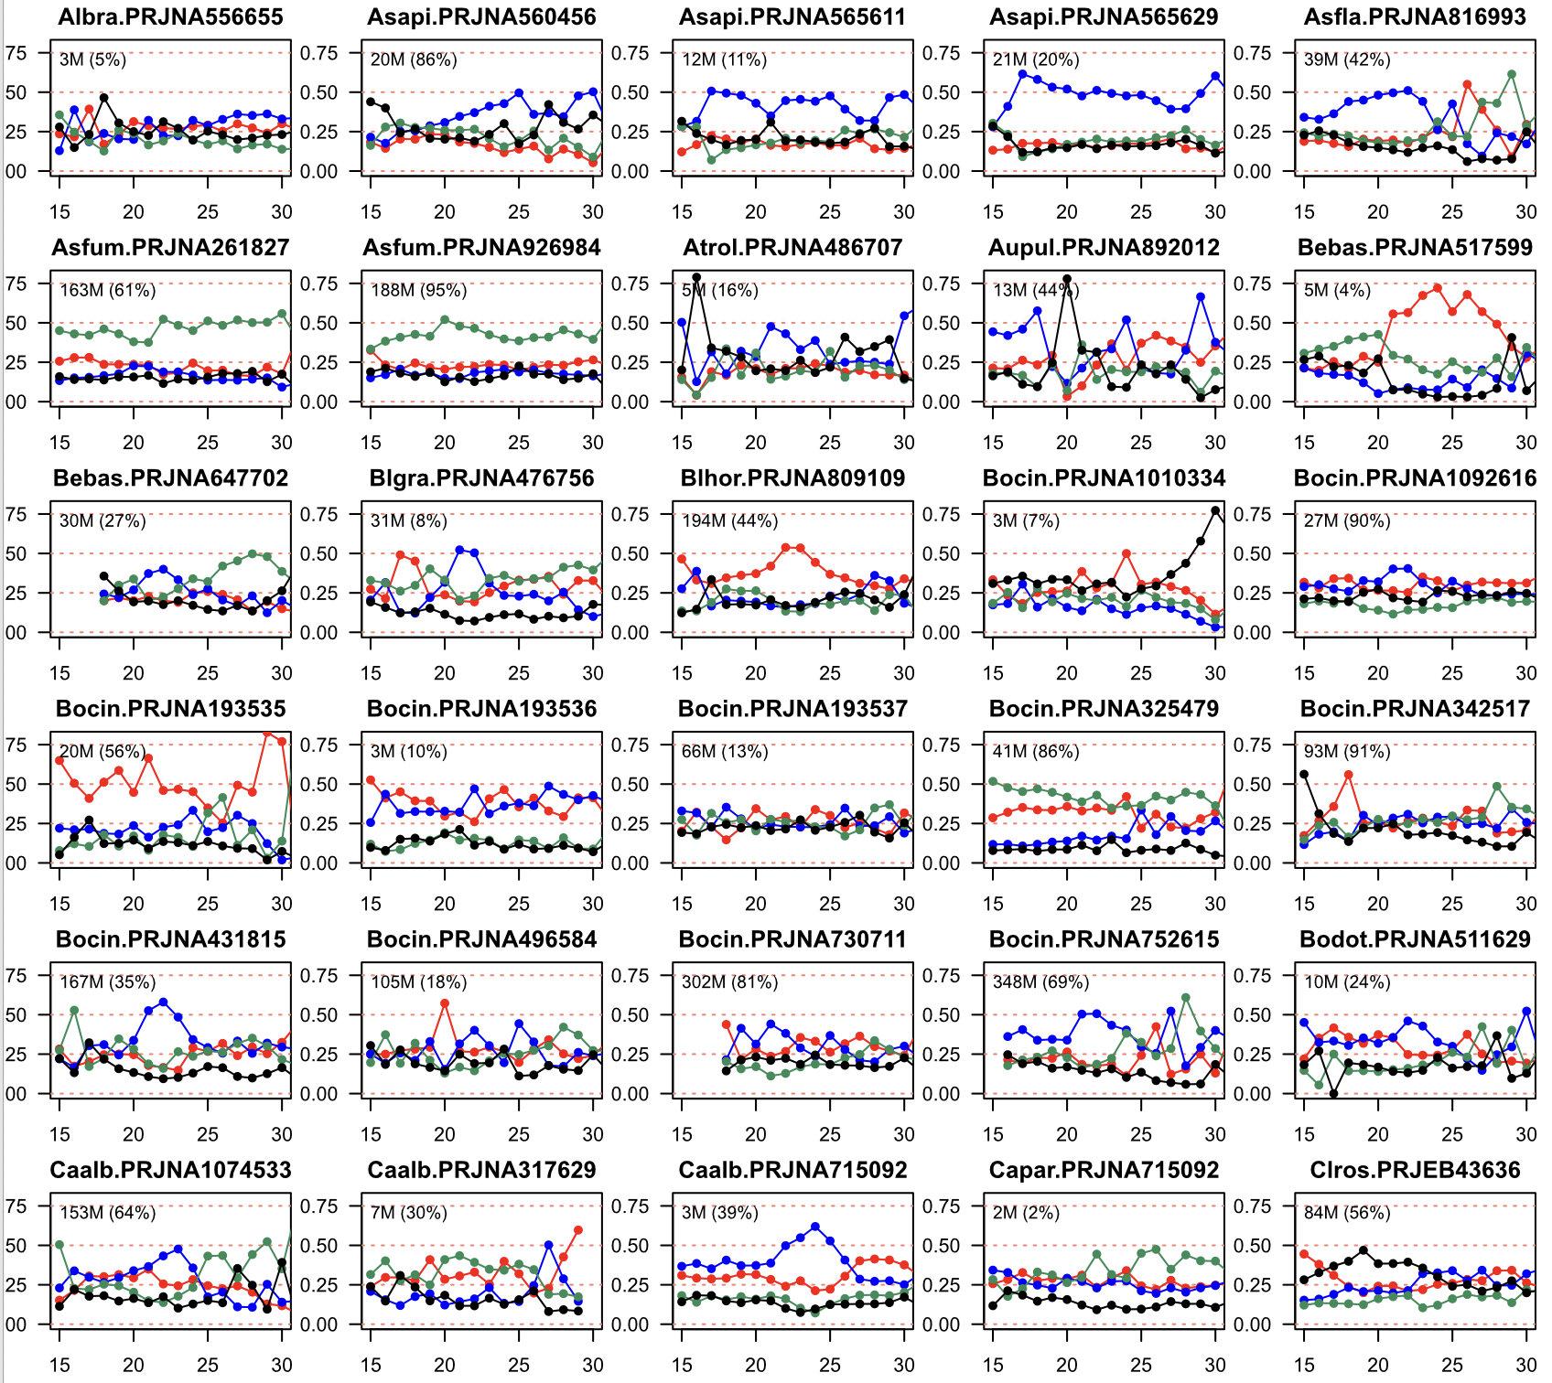
We also observe 5’ bias

Slide 5
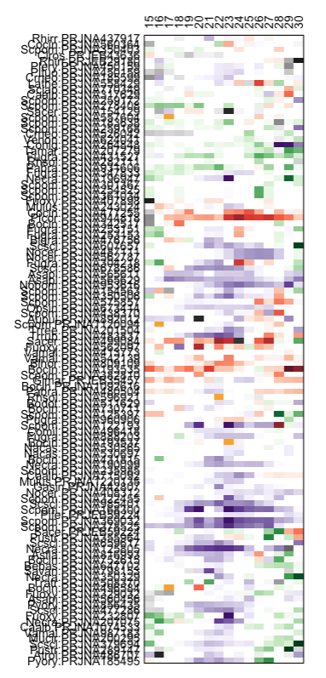

Slide 6
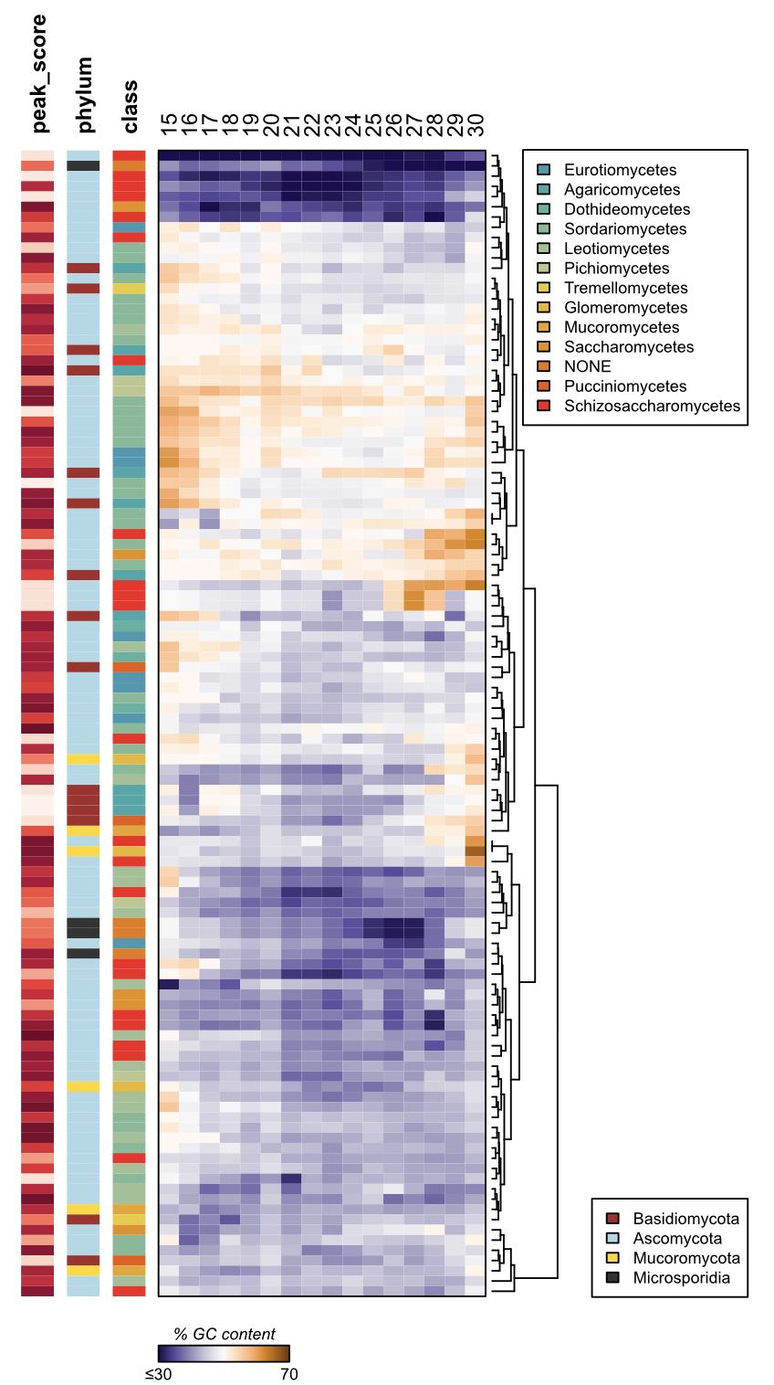
Do we see other symptoms?
Seems like some organisms are biased towards GC.
Remember, the proportion GC + AT = 1

